Slide 1



Li ion battery cells
SMART BATTERY THERMAL MANAGEMENT SYSTEM

Slide 2
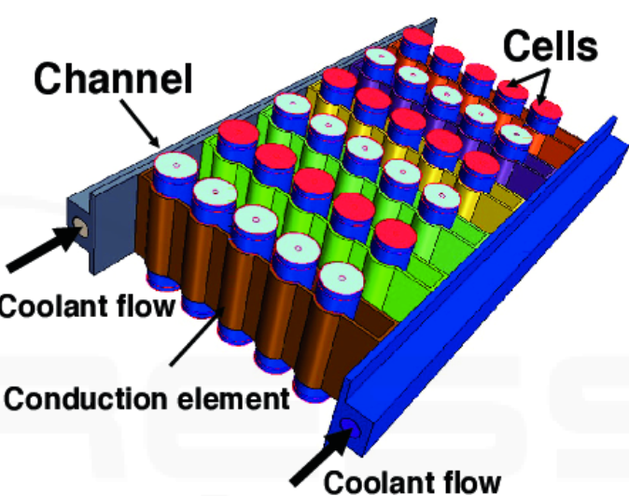
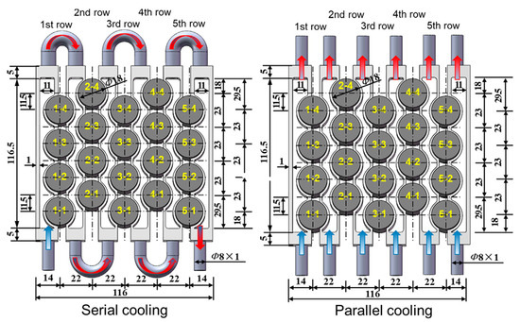
Modern BTMS
Conduction Based
Direct convection based

Slide 3
Main issues
Problem: Some BTMS have a lag in detecting and responding to temperature rise.
Consequence: Delayed cooling triggers, allowing harmful temperatures to be reached before mitigation begins.
Problem: Limited thermal sensors or slow control algorithms may miss early warning signs.
Consequence: Sub-optimal thermal regulation and safety risks.
Problem: Cells heat up at different rates due to internal resistance variations, leading to hot spots.
Consequence: Accelerated degradation, reduced performance, and potential thermal runaway in overheated cells.
Slow Thermal Response
Sensor and Control Limitations
Uneven Temperature Distribution

Slide 4
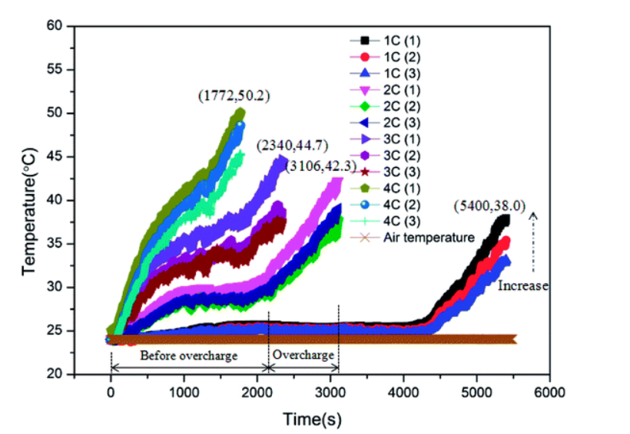
Scientific Data
C refers to Charge rate in this case. 1C means the battery will fully charge in 1 hour, 2C in 2 hours etc.
With the increase in charging rate, the LIB exhibited more serious temperature rise, and less time was required for the battery to experience failure
Source: https://pubs.rsc.org/en/content/articlelanding/2018/ra/c8ra05564e

Slide 5
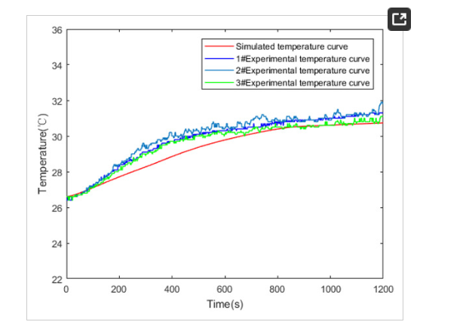
Other data source that matches previous data
The temperature was set at 26 ℃, and the constant current charge was 1200 s at 2 C rate. The comparison of simulated and measured battery temperate curves is shown in Figure 5. Source: https://www.mdpi.com/2032-6653/12/4/250

Slide 6
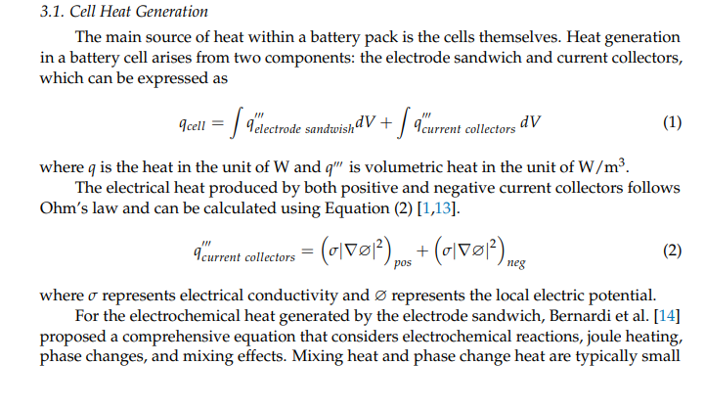
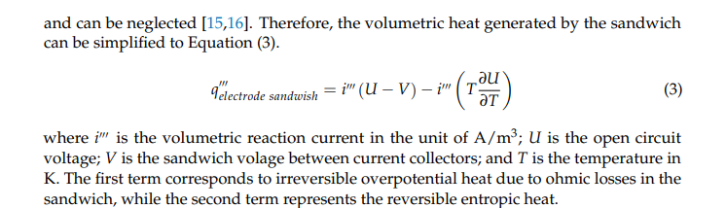
Source: https://docs.nrel.gov/docs/fy24osti/89032.pdf

Slide 7
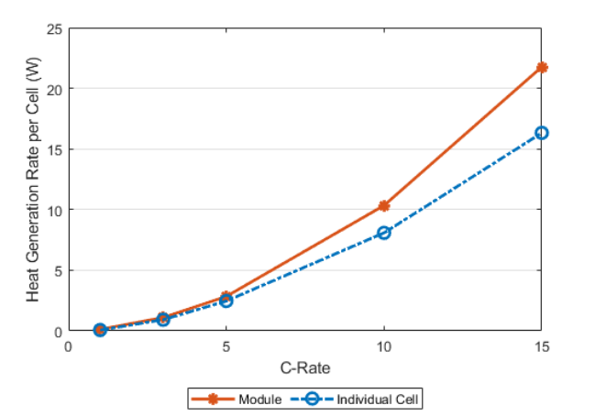
Heat generation rate vs C-rate
Heat generation from a single lithium-iron-phosphate cell within a module compared on a per-cell basis to an identical cell in a stand-alone configuration at different discharge currents. The increase in heat between the individual cell and the module is attributed to joule heating of the module interconnects. In this case, the average interconnect resistance is approximately 0.25 Ω
Source: https://docs.nrel.gov/docs/fy24osti/89032.pdf

Slide 8
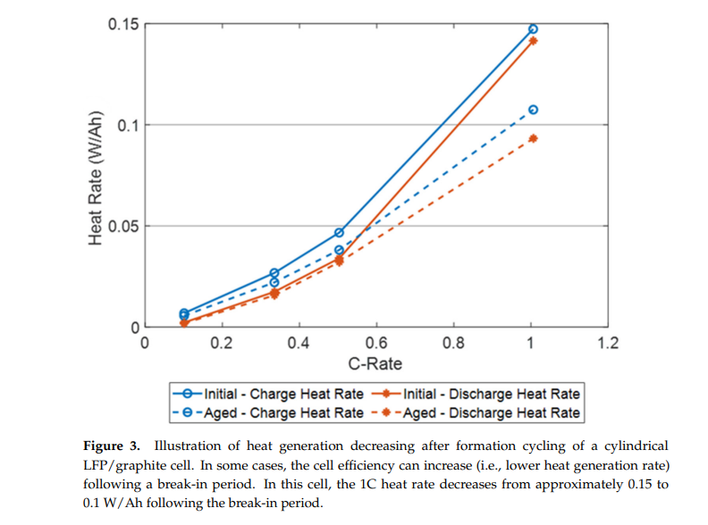
Source: https://docs.nrel.gov/docs/fy24osti/89032.pdf

Slide 9

Our solution
Conductive Plate (Copper) placed in contact with or beneath a matrix of Li-ion cells.
Temperature sensors or thermistors mounted strategically on the plate (not the cells).
Plate has high thermal conductivity and uniform thickness.

Slide 10
How it works?
Heat Transfer: As a specific battery cell begins to overheat (due to internal resistance, imbalance,
or thermal runaway), it radiates and conducts heat to the contacting region of the plate.
Thermal Gradient Formation: The heat spreads along the plate, but the local temperature rise is most prominent near the overheating cell, forming a detectable thermal gradient.
Sensor Feedback: The strategically placed temperature sensors detect non-uniformities in heat
distribution.
Localization: By comparing sensor outputs across the plate, an algorithm can triangulate the region or exact cell causing the heat anomaly.
Trigger Action: Once a hotspot is detected, the system can activate cooling, raise alerts, or trigger shutdown mechanisms.

Slide 11
Advantages
Minimal wiring compared to per-cell sensors.
Passive system—no need for software or sensors embedded in each cell.
Can detect pre-runaway conditions based on subtle heating trends.
Integrates well with battery trays/holders in industrial or EV packs.

Slide 12
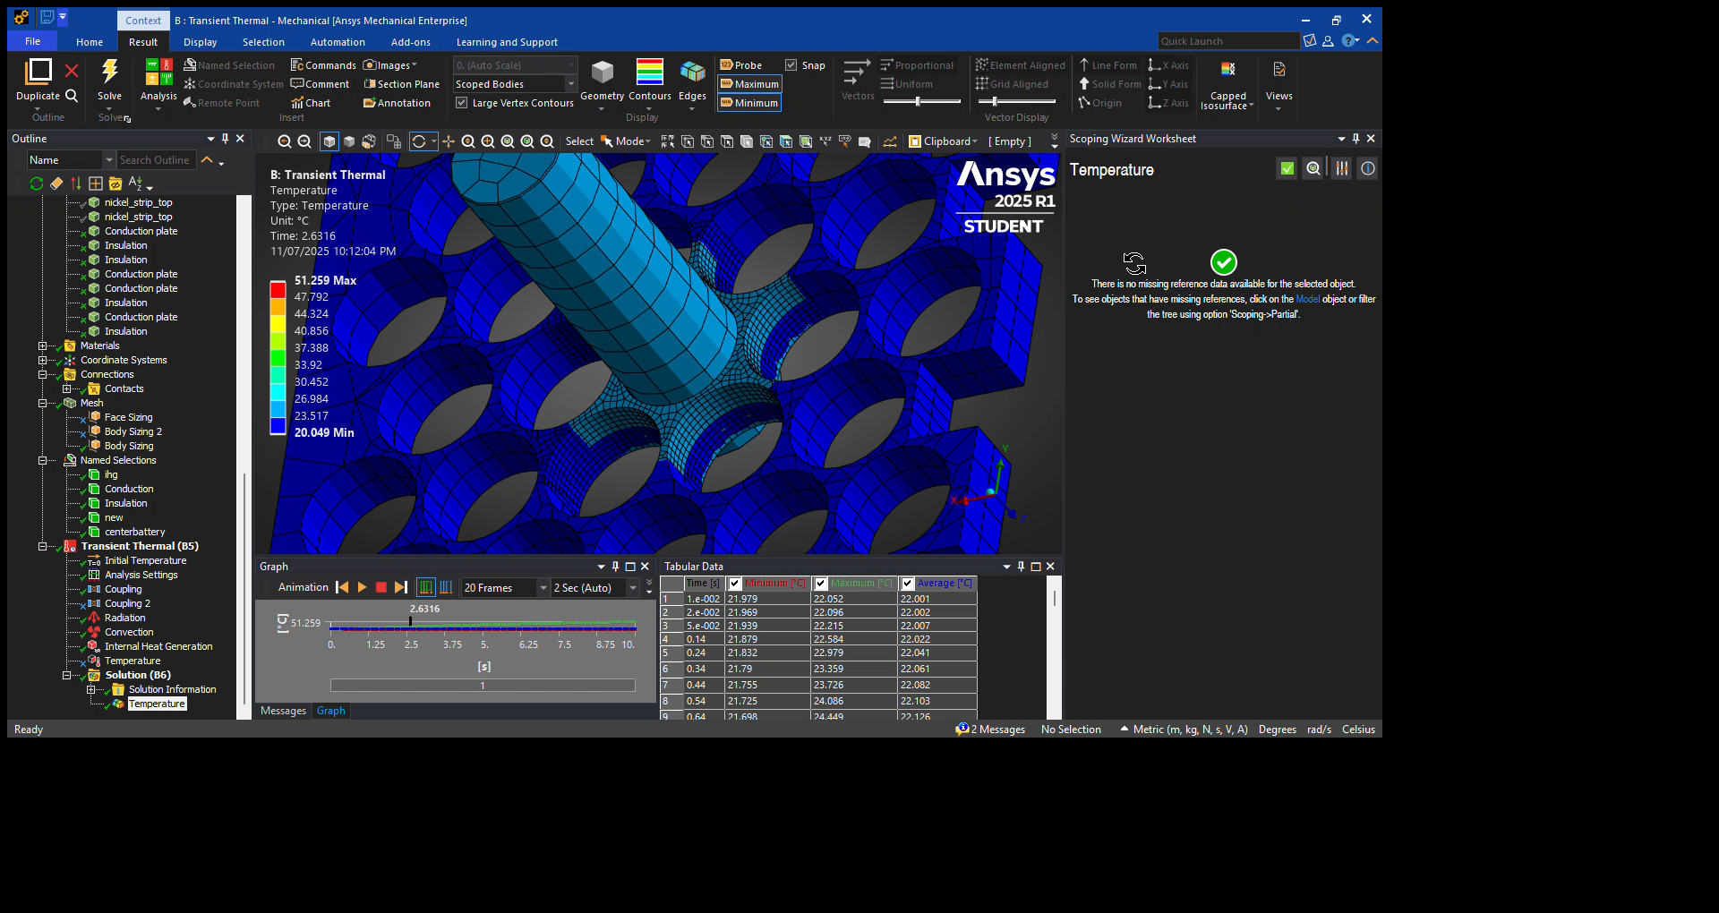
Implementation
Replicating a close enough simulation
Obtaining thermal gradients
Developing code for precise and accurate identification of thermal site

